Slide 1
Key Challenges for Contemporary HRM
Session 3/10
Part I

Slide 2
What are the key challenges for HRM?
The demand-supply gap
Changing employment relations and managing the psychological contract
Demographic trends / Attracting and managing a diverse workforce
The “new career”and increasing workforce mobility

Slide 3
What are the key challenges for HRM?
The demand-supply gap

Slide 4
Shortage of skills
72% of organizations report problems attracting critical-skill employees
60% of organizations report problems attracting high potential and top-performing workers
(Source: Towers-Watson 2012-2013 Global Talent Management and Rewards Study)

Slide 5
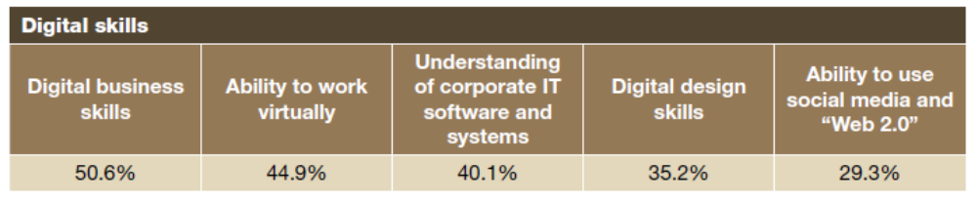
Skills that will be in demand in the future*
Digital skills
*Respondents to the 2012 Global Talent Study

Slide 6
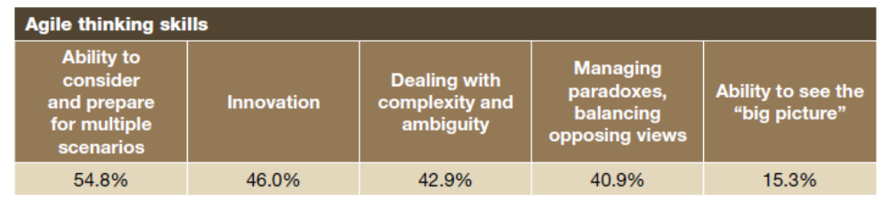
Skills that will be in demand in the future
Agile thinking sills

Slide 7
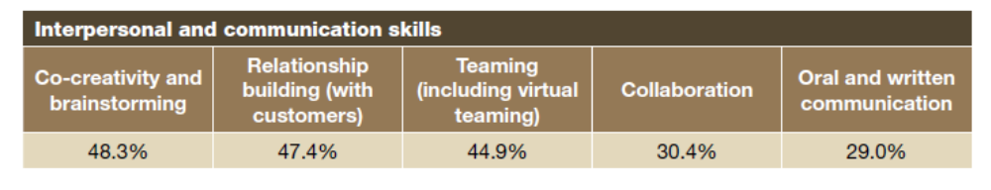
Skills that will be in demand in the future
Interpersonal and communicational skills

Slide 8
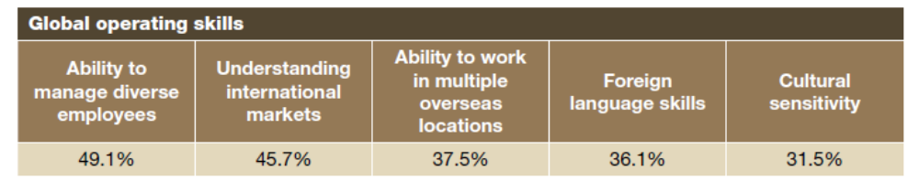
Skills that will be in demand in the future
Global operating skills

Slide 9
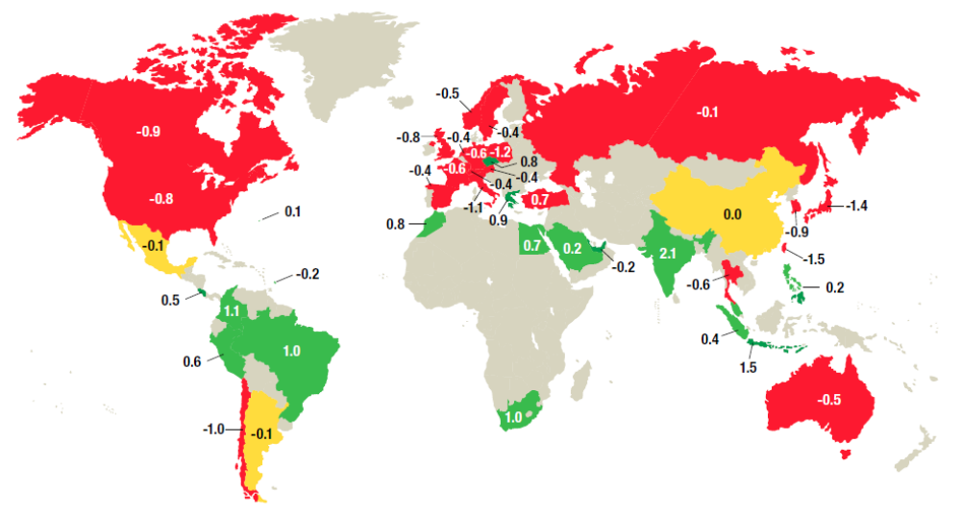
The demand-supply gap
Shortage of talent
Balance between supply and demand
Surplus of talent
(Source: Towers-Watson 2012-2013 Global Talent Management and Rewards Study)

Slide 10
HR Challenge
How to identify, attract, deploy and manage talent?
Recruitment
Selection
Training & Development
Performance & Rewards

Slide 11


